Slide 1
Introduction to Concurrent Data Structures
National Taiwan University NEWSLAB
林祥瑞

Slide 2
Why concurrent data structure?
Definition
A concurrent data structure is a particular way of storing and organizing data for access by multiple computing threads (or processes) on a computer.
Examples
Job queue: Multiple workers fetch and push jobs from a job queue.
Spell checker: The checker thread and trie constructor thread co-operates on a trie.

Slide 3
Jargons
Safety property: No thread ends in error or does something wrong.
Liveness property: Each thread eventually finishes its job.
Fairness property (optional): Each thread has fair turns to do its job.

Slide 4
Lock-freedom - Overview
With mutex and read-write locks, we can make arbitrary data structure concurrently operated by multiple threads.
However, locking leads to some problems, such as
Scalability: It forces workers to “line up”.
Kill-tolerant availability: What if a thread holding panics?
Preemption tolerance: What if locked worker preempts locking worker?
Not all lock-free algorithms satisfies all properties above

Slide 5
Lock-freedom - Example
Enqueue
[Locked]
Enqueue
[Locked]
Dequeue
Thread 1
[Locked]
Dequeue
[Locked]
[Locked]
[Locked]
Thread 2
[Locked]
[Locked]
[Locked]
Enqueue
[Locked]
Thread 3
Example of three threads operating on a queue. The lock forces threads to line up, hurting scalability.

Slide 6
Atomic operations - Overview
Without locks, most non-blocking data structures relies on atomic operations, such as test-and-set, compare-and-swap, fetch-and-add. It features:
Compare-and-swap (CAS) is generalization of test-and-set.
Fetch-and-add, fetch-and-multiply are variants of CAS.

Slide 7
Atomic operations - Example
Enqueue
Enqueue
Dequeue
Thread 1
atomic op
atomic op
atomic op
Dequeue
Thread 2
atomic op
Enqueue
Thread 3
atomic op
Example of three threads operating on a queue. The lock forces threads to line up, hurting scalability.

Slide 8
Atomic operations - CAS
Test-and-set
  function test_and_set(*lock) {
  let old_value = *lock;
  *lock = true;
  return old_value;
  }
Compare-and-swap (CAS)
  function compare_and_swap(*ptr, expect_value, new_value) {
  If expect_value != *ptr {
  return false;
  }
  *ptr = new_value;
  return true;
  }
Test-and-set 奧義：嘗試去上鎖，然後你會得知這個鎖是否之前被鎖上過。
Compare-and-swap 奧義：先檢查變數的值是不是和預期的一樣，若是則換成新值，否則不更動。

Slide 9
Atomic operations - Increment example
Both examples below demonstrates single variable increment. What’s wrong with the unsafe version?
function safe_increase(*ptr) {
while (true) {
let old_value = *ptr;
let new_value = old_value + 1;
if compare_and_swap(ptr, old_value, new_value) {
break;
}
}
}
function unsafe_increase(*ptr) {
let old_value = *ptr;
let new_value = old_value + 1;
*ptr = new_value; // wrong!
}

Slide 10
Atomic operations - Unsafe increment example
Suppose *ptr == 5 in unsafe example.
old_value = *ptr;
// 5
*ptr = new_value;
// 6
Thread 1
old_value = *ptr;
// 5
*ptr = new_value;
// 6
Thread 2

Slide 11
Atomic operations - Safe increment example
Safe example using CAS.
old = *ptr;
// 5
CAS(ptr, old, new);
// OK
Thread 1
old = *ptr;
// 5
CAS(ptr, old, new);
// Fail and retry
Thread 1
Remark:
It’s lock-free but NOT wait-free.
Wait-free implies lock-free, but the reverse does not.

Slide 12
Atomic operations - Trie construction
A trie is a data structure stores a set of words. The root node indexes first character, the second-level nodes index second character.
(root)
h
x
terminate=0
terminate=1
e
i
struct Node {
bool terminate;
Node* children[26]; // From ‘a’ to ‘z’
}
terminate=1
terminate=1
Example of structure of trie node storing plain lower-case English words.
A trie with “he”, “hi” and “x” keys.

Slide 13
Atomic operations - Trie construction
Reader: Search from root to leaf, return found if it terminates at a node with terminate flag is true.
Writer: Search from root to leaf. Allocate new node whenever it meets a NULL pointer, and set terminate flag to true when it ends.
function unsafe_search(*node_ptr, *word_ptr) {
if node_ptr == NULL { return NOT_FOUND; }
if word_ptr == NULL {
if node_ptr->terminate { return FOUND; }
else { return NOT_FOUND; }
} else {
let character = *word_ptr;
return unsafe_search(
node_ptr->children[character], word_ptr + 1
);
}
}
function unsafe_insert(*node_ptr, *word_ptr) {
if word_ptr == NULL {
node_ptr->terminate = true;
return;
} else {
let character = *word_ptr;
if node_ptr->children[character] == NULL {
node_ptr->children[character] = new Node;
}
unsafe_insert(
node_ptr->children[character], word_ptr + 1
);
}
}

Slide 14
Atomic operations - Trie construction
Is it safe with single writer and multiple readers without atomic ops? Yes
  Because only the writer modifies the data structure.
What if multiple writers? You get dangling nodes!
  Suppose two writers insert new node at same place. Chances are that both writers see NULL child pointer, and both insert new nodes, resulting in one dangling node.
root
The edge is stolen by T2.
child is NULL
Allocate node & insert
e
T1
T1’s node
T2’s node
child is NULL
Allocate node & insert
-> dangling node
T2

Slide 15
Atomic operations - Trie construction
We can apply atomic CAS to check if original pointer is NULL and then insert new node in single operation.
function unsafe_insert(*node_ptr, *word_ptr) {
if word_ptr == NULL {
node_ptr->terminate = true;
return;
} else {
let character = *word_ptr;
while true {
if node_ptr->children[character] == NULL {
let child = new Node;
if !CAS(&node_ptr->children[character], NULL, child) {
delete child;
continue;
}
}
unsafe_insert(node_ptr->children[character], word_ptr + 1);
}
}
}

Slide 16
Linked list example - Overview
How to insert new node to list?
Without atomic ops, concurrent insertion causes dangling nodes.
Like trie insertion, we apply CAS to prevent this.
In next slide, we will demonstrate insertion using atomic ops.

Slide 17
Linked list example - Insertion
On insertion, each thread remembers the pointer to be modified, and allocate nodes of its own.
head
NULL
Thread 1’s node
Thread 2’s node

Slide 18
Linked list example - Insertion
Then, each thread CAS the original red pointer to the new node. In following example, thread 1 (T1) does so first, and then thread 2 (T2). T1 succeeds while T2 fails on CAS.
head
NULL
T1’s node
T2’s node

Slide 19
Linked list example - Insertion
T2 then acknowledges old link is modified and repeat the whole process. At the end it will succeeds.
head
NULL
Thread 1’s node
Thread 2’s node

Slide 20
Linked list example - Update
What if T1 updates the value of a node?
If the value can be atomically updated, T2 is safe to read the value without locks.
Otherwise if the value is large struct, T1 should lock to protect the value.
How to do it without locks?
head
T1 updates value
NULL
T2 reads value (unsafe)

Slide 21
Linked list example - Read-copy-update
The safely update value without locks, T1 performs read-copy-update (RCU):
Read: T1 reads the pointer to the node.
Copy: T1 clones the entire node.
Update: T1 updates value in cloned node.
Finally, T1 inserts cloned node using CAS, and discards original node.
T1 clones node and updates value
head
Copied node
奧義：建立副本作爲替代品，再過河拆橋
old node
NULL
CAS the pointer
T2 reads old value (safe)

Slide 22
Linked list example - Deletion
Can we achieve deletion by solely CAS? Things would go wrong.
Suppose thread 1 deletes B by CAS A’s succeeding pointer.
At the same time, thread 2 inserts D between B and C by modifying B’s succeeding pointer.
It results in dangling B and D.
head
A
B
C
NULL
D

Slide 23
Linked list example - Deletion
One solution is marked pointer. It can be done on aligned architecture by putting the marks in low-bits of pointer.
In previous example, the deleting thread marks the to-be-deleted B’s pointer. Then, CAS preceding A’s pointer.
Other threads inserting b/w B and C will fail on CAS.
On ARM, each pointer is 8-byte aligned, leaving 3 low bits untouched.
[high-bits = poiner][low-bits = mark]
head
奧義：不希望別人動的東西先封印
2. CAS
1. mark
A
B
C
NULL
D

Slide 24
Linked list example - Deletion
How to implement marked pointer on unaligned architecture like x86_64?
x86_64 has cmpxchg16b instruction, we place 8-byte pointer and 8-byte mark in contiguous memory, and CAS on whole 16 bytes.
Modern GCC has built-in __int128 type and __atomic_compare_exchange_n built-in function.
Here is example in the wild.

Slide 25
Linked list example - Memory deallocation problem
What if the deletion is performed while another thread is accessing this node?
It’s possible reading thread accesses to to-be-deleted thread when deletion is in process.
head
3. Thread 1 CAS the pointer to B.
A
B
C
NULL
1. Thread 2 enters to B.
2. Thread 1 marks the pointer.
4. Thread 1 deallicates B.
5. Thread 2 reads B. (segfault)

Slide 26
Memory reclamation problem
We call this class of problem as memory reclamation problem. How readers and writers coordinate with each other in terms of dynamic memory allocation?
We usually separate memory reclamation problem with data structure design.
It’s a young field that robust and careful designs appear after 2000s.
  Scalable Lock-Free Dynamic Memory Allocation - Maged M. Michael (2004)

Slide 27
Memory reclamation problem
So how to resolve this?
Read-write locks: Waits until all reader exits.
Garbage collector: Requires designated thread. Suitable for Python and Java, but not for static typed language like C/C++/Rust.
Runtime-less methods
  Epoch-based: Blocks all the objects in the epoch from being garbage collected.
  Hazard pointer: More fine-grained compared to epoch-based method.

Slide 28
ABA problem - Overview
Why called ABA problem?
Imagine you’re waiting for a traffic light. You see the red and then focus on your phone. After some seconds, you look up again and it’s still red.
Can we assume the light keeps red all the time? Potentially it turned green once and you blocked the traffic.

Slide 29
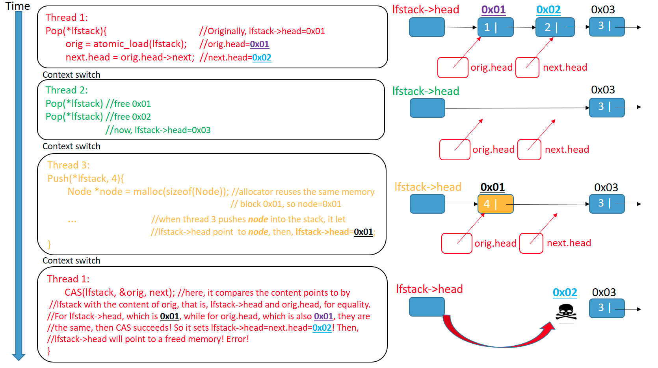
ABA problem - Stack example
Reference: https://lumian2015.github.io/lockFreeProgramming/aba-problem.html

Slide 30
ABA problem - Solution
The problem arises from the Compare of CAS step. To mitigate this, we can add an extra tag, or modified counter, along with pointer. We increase the tag by one whenever the pointer is modified.
let (orig_ptr, orig_tag) = node->head;
let new_tag = orig_tag + 1;
CAS(&node->head, (orig_ptr, orig_tag), (new_ptr, new_tag));

Slide 31
Practice - Implement concurrent hash table
The heart of hash table design is collision handling:
Chaining: Each bucket is a linked list
Probing: A class of re-hashing techniques
The design of concurrent operations is not much harder than concurrent linked list.

Slide 32
Practice - Concurrent skiplist
Skiplist can be treated as multi-level linked list.
head
NIL
1
5
9
1
5
7
9
1
3
5
7
9

Slide 33
Practice - Concurrent skiplist (2)
Should we insert from top to bottom or from bottom to top?
What if the red node is destroyed during insertion?
head
NIL
1
5
9
1
5
6
7
9
1
3
5
6
7
9

Slide 34
Practice - Concurrent skiplist (3)
Should we delete from top to bottom or from bottom to top?
Does ABA problem occur?
head
NIL
1
5
9
1
5
7
9
1
3
5
7
9

Slide 35
Implementations
Known lock-free data structures:
Red-black tree
Skiplist: Regard of skiplist as multi-level linked list!
Channels: Lock-free communication among threads. Widely used in Go and Rust.
Known implementations:
Libcds: C++ library
System.Collections.Concurrent: C# standard library
Crossbeam: Concurrent data structure collection in Rust

Slide 36
Q & A

